Slide 1
AUTONOMOUS CAR – A SELF DRIVING CAR INTEGRATED WITH DETECTIONS
PROJECT DOMAIN – MACHINE LEARNING PLUS FPGA
STUDENT NAME: CH. VINAY KISHOR – N160187
PROJECT GUIDES:
Mr. SK. IRFAN ALI Asst.prof(E.C.E Dept.)
Mr. P. SHYAM Asst.prof(E.C.E Dept.)
RAJIV GANDHI UNIVERSITY OF KNOWLEDGE TECHNOLOGIES - IIIT NUZVID

Slide 2
INTRODUCTION
ABSTRACT:
PROBLEM:
Every year millions of deaths are happening due to car accidents. So, this is an issue of serious concern. Deaths/serious injuries in car accidents effects the families of the individuals completely for their life time. As per the observations, the primary causes of these accidents are cellphone usage while driving, over speed, violation of traffic rules, alcoholic consumptions, bad weather conditions etc.,

Slide 3
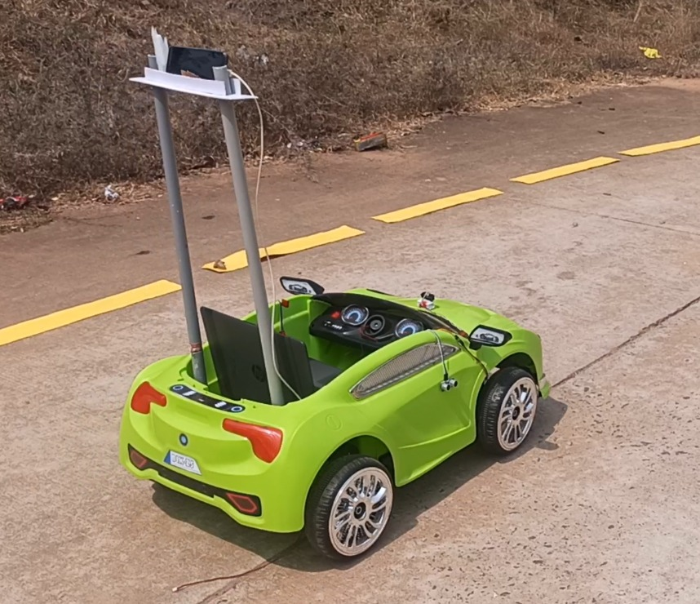
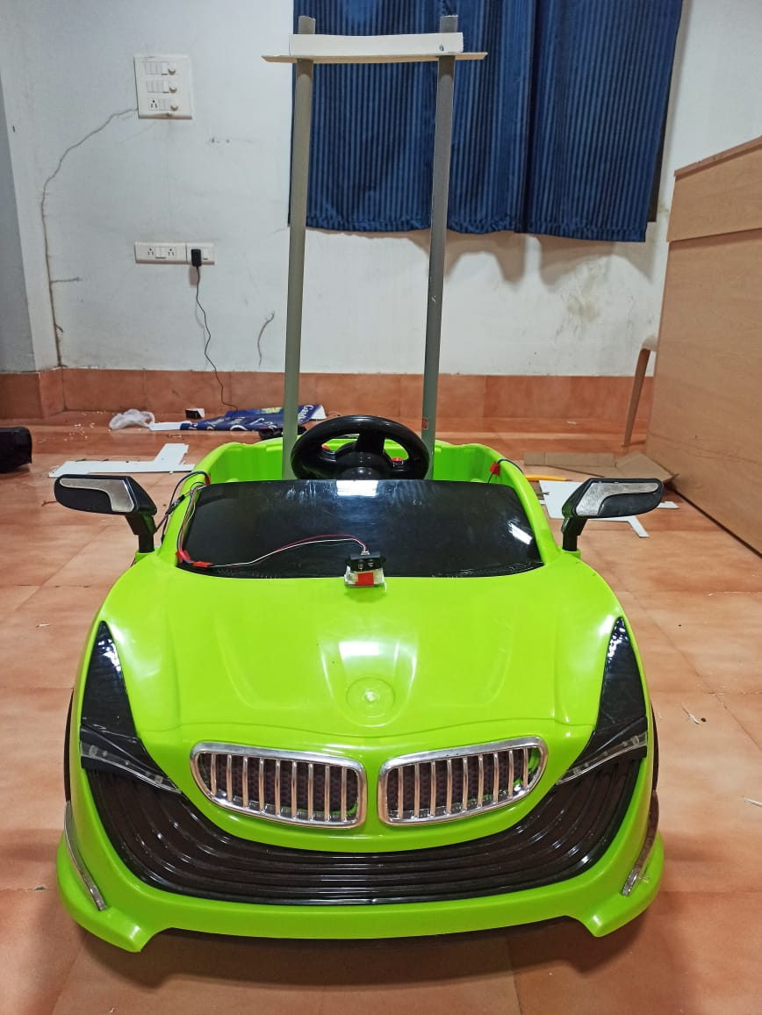
SOLUTION:
To overcome these serious issue I come up with a solution to design an autonomous car by using DE10 Nano FPGA board

Slide 4
FEATURES
1. Collision Avoidance System 2. GPS based routing of vehicle 3. Lane Detection 4. Object/ Obstacle Detection

Slide 5
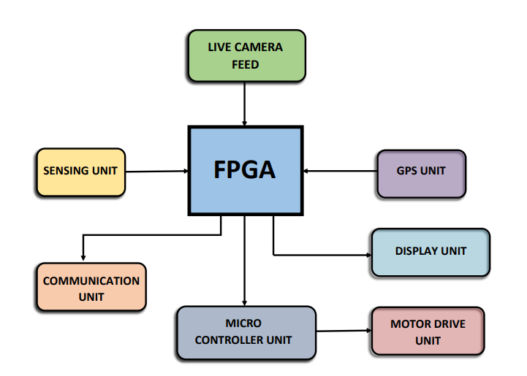
BLOCK DIAGRAM

Slide 6
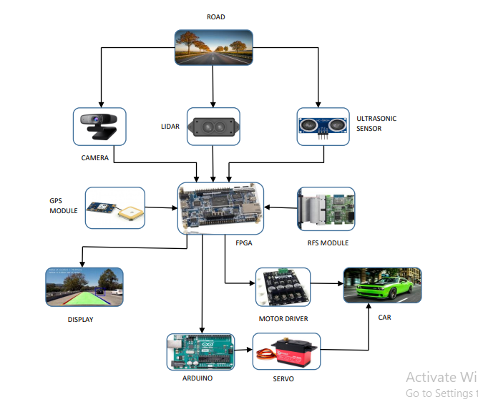
DESIGN

Slide 7
INPUT DEVICES: CAMERA, LIDAR, ULTRASONIC SENSOR, TF MINI LIDAR, GPS MODULE
OUTPUT DEVICES: ARDUINO, MOTOR DRIVER, SERVO MOTOR
I am using DE-10 Nano FPGA board for lane detection as I am using FPGA vision Sobel filter/edge detection algorithm on concept basis of Hough transform and SVM. I used FPGA for obstacle detection using Haar cascade algorithm. And I used FPGA for Global positioning system (GPS). FPGA analyses and process the input data that is received from sensors and camera and pass the control signals to Arduino. And Arduino controls the car with the help of Motor driver.

Slide 8
Purpose of the Design:
This plan spins around the idea of self-driving vehicles with the most recent innovation of FPGA. The focal thought behind this plan is to avoid the accidents due to human negligence, with maximum possible extent. We might stay away from the wild fender benders, thoughtless driving, crummy choice taken by drivers, infringement of traffic rules and over speeding, and so forth Then again, in the forthcoming years, it is going to assume a pivotal part in the car business. This plan has the ability and usefulness with a wide scope of utilizations for any vehicle. Plan of our task can be utilized in various regions primarily on-street vehicles (i.e., car, truck, bus, and any other transportation vehicles).

Slide 9
Application Scope:
This thought has immense applications in different fields.
1. Modern transportation and products transportation turns out to be more available and more secure.
2. Automation can be utilized in different fields like cultivating and agri business, development and mining.
3. Physically handicapped people are free to access this car.
Targeted Users:
Now a days, Autonomous vehicles are having a great demand at Automobile industries. In our project, I mainly focused on real time specifications and I integrated Machine learning with FPGA into the field of Autonomous vehicles. Physically challenged people can access this car. It has a vast range of uses in Modern transportation and product transportation. And by integrating some detections it can be useful for Agriculture and Military applications also.

Slide 10
Expected Sustainability results and Performance Parameters:
1. Collision Avoidance system: Our car should be able to avoid Collison from moving objects or non moving objects. If any object detected with in a range of 150cm-300cm, Then it will adjust the path with respect to the detected object. In necessary condition car will stop and it will move with respect to the moment of the object. similarly collison may occur at the sides and back of the car due to the movement of objects from different directions. so our model will be able to avoid that type of collisons too, with in a range of 50cm-100cm.
2. GPS based routing of vehicle: Our car should be able to follow the path given by the user. As user gives the final destination point as input through Global positioning system (GPS). and our model has to find the best route and gives the distance information to the user as check points.
3. Lane detection: Our car should be able to follow the lanes. Generally there are so many types of lanes present on the road such as single lane, double lane, dividers etc. and some roads may did not contain any lanes too. Hence our model has to predict all types of lanes and it should follow edge detection for the roads that did not contain lanes.
4. Object/ Obstacle detection: Our car should be able to detect Objects/ Obstacles. Generally there are many objects present or moving on the road. Our model should detect both moving and non moving objects and it will take the decisions for steer moving with respect to the distance and stability of objects. Similarly it should detect traffic signals too.

Slide 11
Components used for making Autonomous car:
1.DE10 Nano FPGA board
2. Intel cloud connectivity kit
3. Light detection and Ranging sensor (TF MINI LIDAR)
4. Ultrasonic sensor (HC-SR04)
5. Camera
6. Arduino
7. Motor Driver
8. GPS Module
9. Servo motor

Slide 12
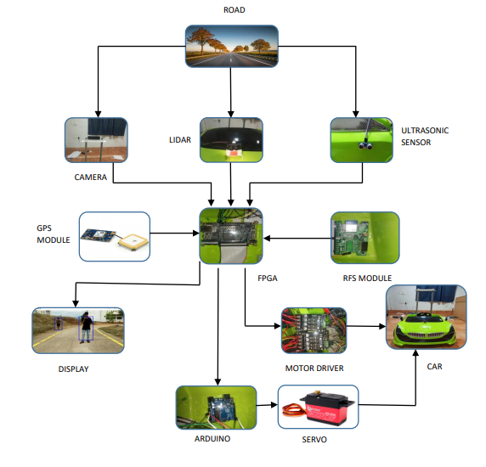
DESIGN FLOW WITH ACTUAL COMPONENTS

Slide 13
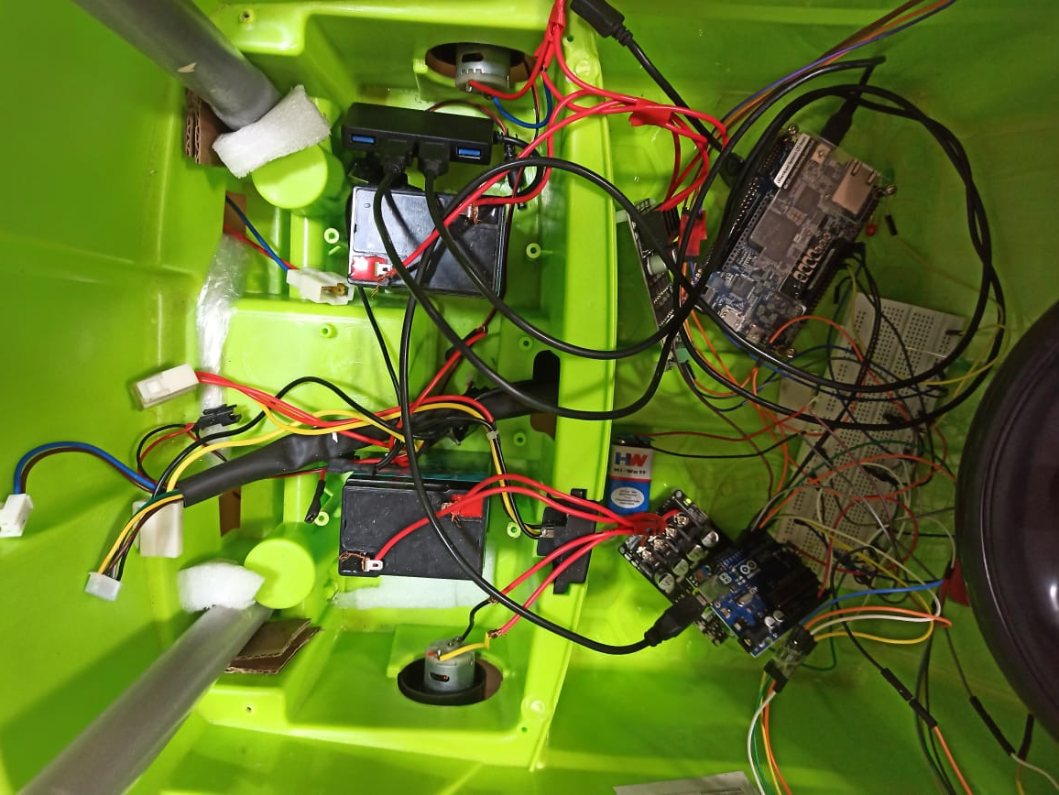
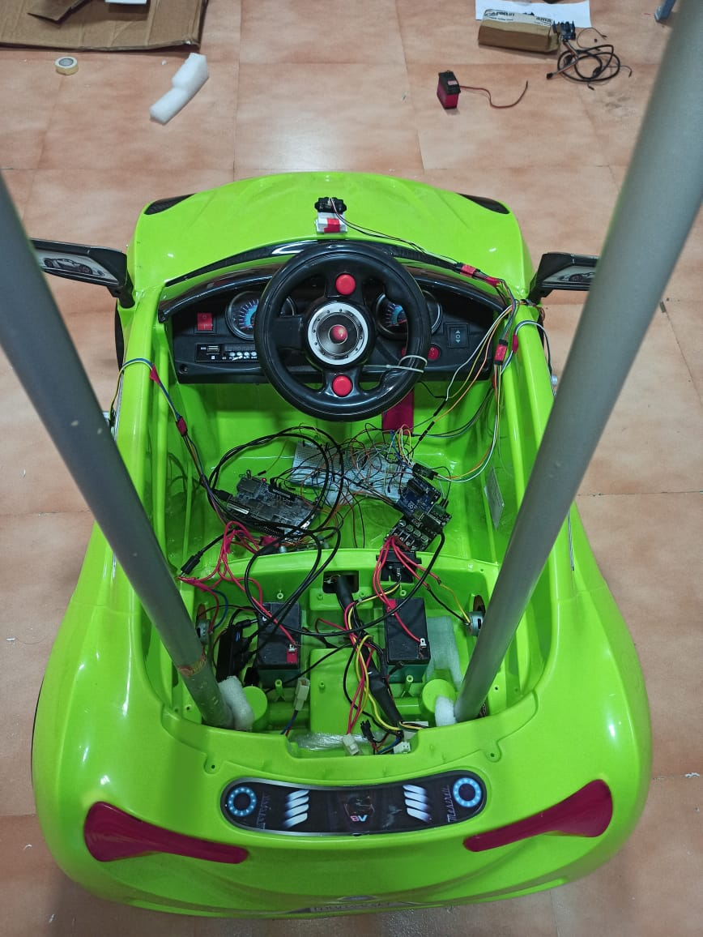
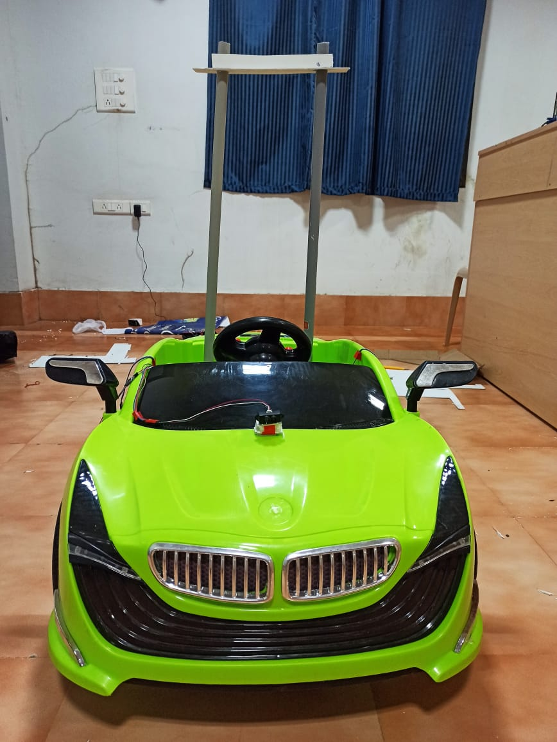
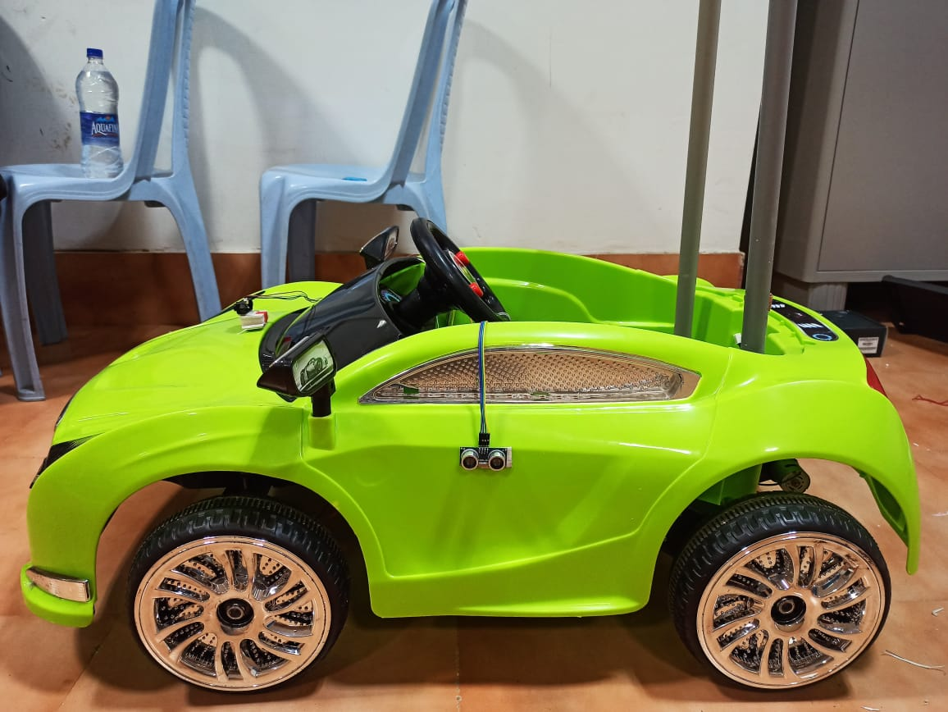
CONSTRUCTION
By connecting the components to the car, as per above design flow we have

Slide 14
DESIGN PROCEDURE
Turning control and steering control of car depends upon Object detection and Lane detection. Collison Avoidance system depends upon Ultrasonic sensor and TF Mini LIDAR. GPS Module is used for Tracking and Planning Route map(Current location - Destination). All Input data and Output data is stored in cloud by RFS Module and It can be accessed by Administrator.

Slide 15
DETAILED DESIGN PROCEDURE
Camera: By taking the live camera feed, I performed Object detection and lane detection through Hard Processor System (HPS) in DE10 Nano FPGA Board.
1.1 Object detection:
Object detection is a key component in the self-driving cars by combining with the sensors, which helps in decision making and motion control while ensuring the stability of the vehicle. In our design, we have implemented the object/human detection algorithm with pre-trained Haar-Cascade and Linear Support Vector Machine Model using Opencv Computer Vision library with python for demo purpose.
Our car should be able to detect Objects/ Obstacles. Generally there are many objects present or moving on the road. Our model should detect both moving and non moving objects and it will take the decisions for steer moving with respect to the distance and stability of objects.

Slide 16
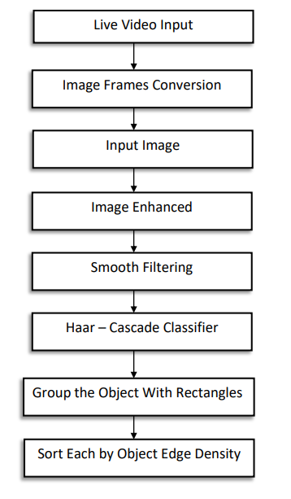
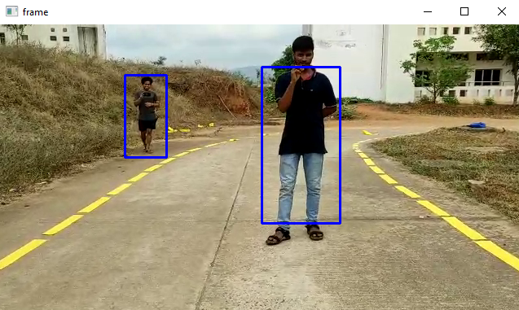

Slide 17
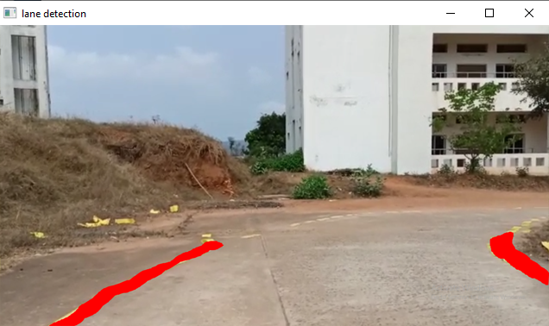
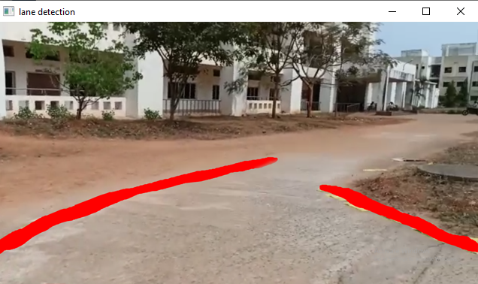
1.2 Lane detection:
Lane detection is one of the primary element in our Autonomous car. Our car should take turnings with respect to lanes. Watching lane lines highlighted by the computer vision algorithm as the vehicle moves give a great joy of accomplishment. Detecting lane lines is indeed a very crucial task. It provides lateral bounds on the movement of the vehicle and gives an idea about how much deviated, the car is from the center of the lane. Lane detection relies only on camera images. We apply computer vision techniques to process the image and give lane markings as the output. We have used the OpenCV library to implement the Lane Detection Algorithm. Based on detected lane output we build the path planning algorithm.

Slide 18
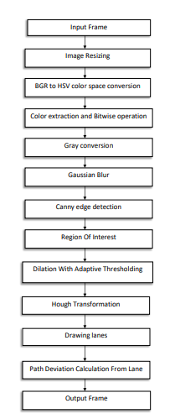
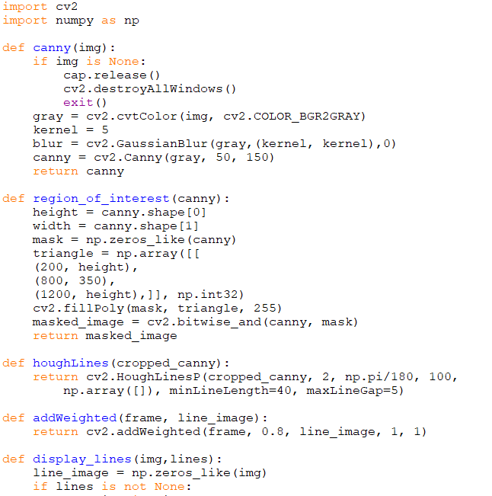

Slide 19
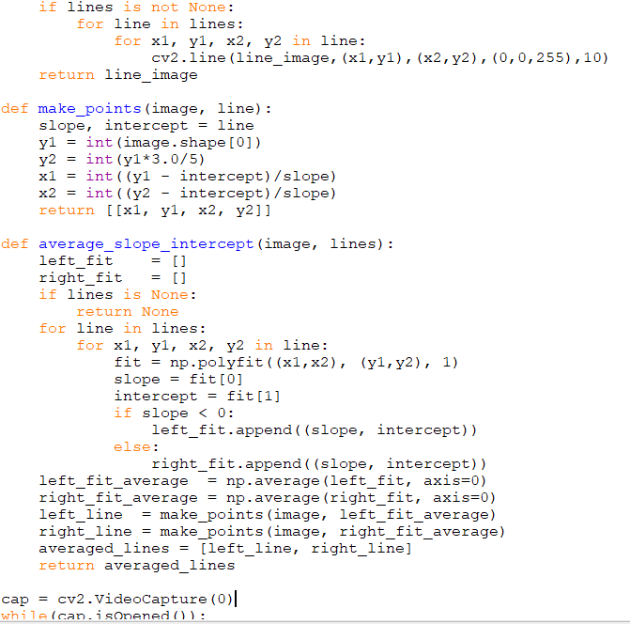
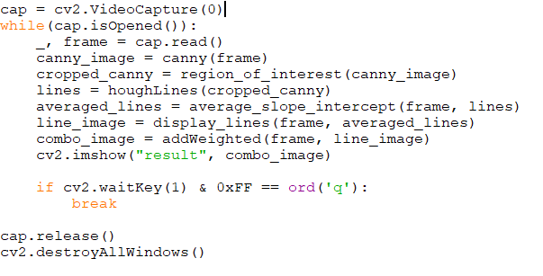

Slide 20
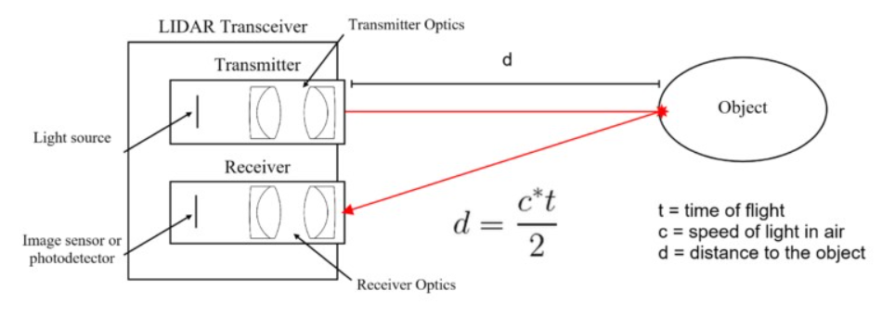
2. TF MINI LIDAR
The LiDAR works on the principle of “Time of Flight”. It uses ultraviolet, visible or near-infrared sources to sense objects. The light energy emitted by the LiDAR is known as Pulse and the reflected light from the object is know as return. The LiDAR system sends pulse and waits for the pulse to return. It measures how long it takes for emitter pulse to return back to the sensor. In the end it gets the variable distance of the objects. The equation that used to show up at the exact distance of the object is as per the following: Distance = [(Speed of Light) x (Time of Flight)] ÷ 2.
If LIDAR Detects an object(which is in front of the car) with in a range of 150cm-300cm, Then it will adjust the path with respect to the detected object. In necessary condition car will stop and it will move with respect to the moment of the object.

Slide 21
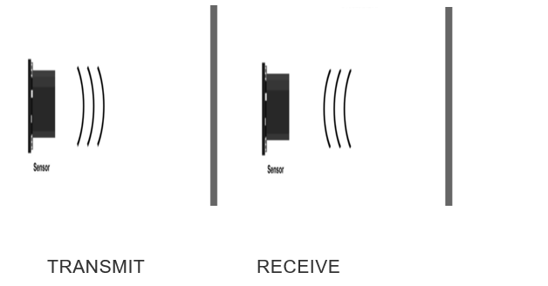
3. Ultrasonic Sensor:
An ultrasonic sensor is an instrument that measures the distance to an object using ultrasonic sound waves. An ultrasonic sensor uses a transducer to send and receive ultrasonic pulses that relay back information about an object’s proximity. The working principle of this module is simple. It sends an ultrasonic pulse out at 40 kHz which travels through the air and if there is an obstacle or object, it will bounce back to the sensor. By calculating the travel time and the speed of sound, the distance can be calculated. For presence detection, ultrasonic sensors detect objects regardless of the color, surface, or material.
We will call the time to transmit and receive is known as Time of Flight. By this time of flight we can find distance by using below formula:
Speed of sound = 29us /cm (in room temp)
Time of Flight = T0
Range =Time of Flight / (2*Speed of Sound)
Collison may occur at the sides and back of the car due to the movement of objects from different directions. so our model will be able to avoid that type of collisons too, with in a range of 50cm-100cm.

Slide 22
4. GPS MODULE:
In our project GPS routing also plays a crucial role where the car needed to follow a specified path given by user. For GPS routing we are using azure map services and current GPS location of the car. Azure map services is one the features in azure IOT edge. I am using an API which consider two coordinates that are starting and the end point of the required location. By using the get request we can obtain GPS points in between the given two previous coordinates. The get request will also gives the total count of the coordinates in between starting and the ending positions, and it points the exact location. From Azure maps we get the coordinates from current to destination location, these set of coordinates will be sent to the FPGA Board there the board checks and gives the instruction to the car to moves from current coordinate to the nearest coordinate from the set of coordinates given by the Azure map this process continues until the car reaches the destination. The set of coordinates given by the azure maps is our checkpoints, after reaching each checkpoint, the map will be updated in Website.

Slide 23
5. DE10 NANO FPGA BOARD:
DE10 NANO board is the main processing and controlling unit of the system. To work all processes and parallel works we have ARM cortex Processer and DDR3 memory. For car position and sensor details values comes from RFS module. Board 2 gpio header , so in that 1 header will goes to RFS and for one header we will send control signals to motor drivers , send signals and receive data from our sensors. Based on the Lane detection and collision detection the steering of the vehicle is changed. From gps module the current coordinates of the car taking into board.
The detections and data coming from the board will be sent to cloud by the FPGA board, from there the data will be transmitted to the website where it displaying the RFS data, Detections and location of the car.

Slide 24
6. RFS Module:
Cloud computing: Cloud computing is a platform that provides access to the computing resources over the internet. Cloud providers own massive datacenters which have hundreds of servers, storage systems and components critical to the organization’s working. Cloud computing is used for the following types of services: 1.Creating and testing applications 2.Hosting blogs and applications 3.Machine learning and data analysis 4.Data storage and backup 5.Streaming media content 6.Automating software delivery etc.
Microsoft Azure is a cloud computing service provided by Microsoft. It is actually an online portal through which we can access and manage resources and services. It supports wide variety of languages like C++, Java, Python etc. We can handle events easily through internet and Azure IOT hub is reliable for IoT integrated technologies.
How I am using Azure cloud for our project? 1.In my project, I used Azure cloud for monitoring sensor and Radar data, situation of the car premises, and GPS locations. 2.Azure services plays crucial role in my project, without azure VM services we are unable to host our website. 3.Azure IoT Hub also used for me to store RFS details which is used in determination of vehicle status and the motion condition and for estimating the angle of curve rotating.

Slide 25
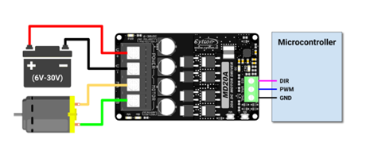
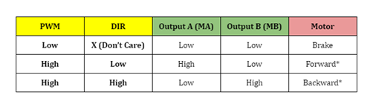
7.Motor driver:
1. I used MD20A motor drivers for vehicle movement , The MD20A takes 6-30 V DC power supply and by control signals the motors will run.
2. Motor Driver has 3 control pins which acts as a micro controller and those are PWM(pulse width Modulation), Ground and Direction pin.
3. By giving control signals as 0 or 1 we can run our motors in forward direction or reverse direction or full speed or stopping all these can be done by this driver.
4. For supply I gave external power supply to motor driver and as for control signals the input came DE10 NANO FPGA board.
5. When there is no objects in collison range the board will give 1 as PWM and direction 0 , So the car moves forward, If it is in collison range the PWM becomes 0 and car stops.

Slide 26
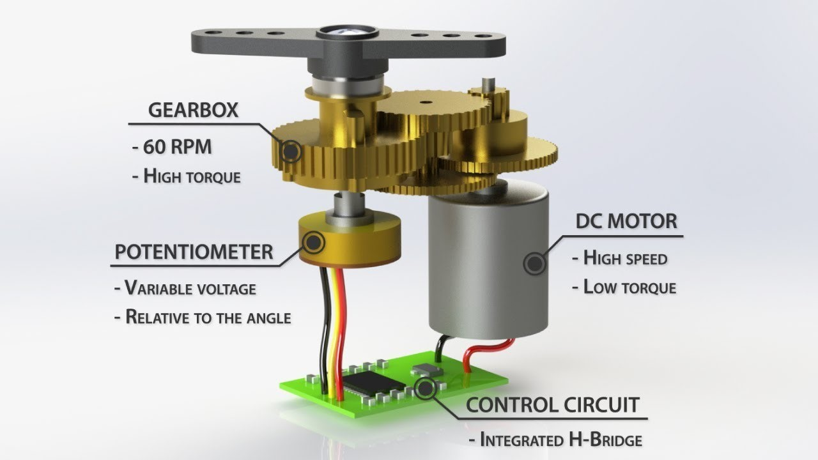
8. Servo Motor:
Servo motor is a high precision motor which have a high accuracy over angles and feedback system.
The function of the servo motor is to convert the control signals into rotational angular displacement of the motor shaft.
In our project we need a high precision angles for steering control so we used servo. The servo has 3 pins , VCC,Ground,PWM. By the width of the PWM we can control the angle of the servo.
For the purpose of high precision width of PWM we gave PWM from Arduino. By giving control signals to Arduino we can control the servo whenever it need to turn.
By this servo I steer our vehicle left or right with high precision.

Slide 27
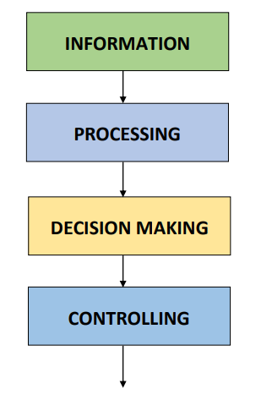
SYSTEM DESIGN SCHEME

Slide 28
SUSTAINABILITY RESULTS:
For obstacle detection our car is abled to detect Objects/ Obstacles. Generally there are many objects present or moving on the road. Our model detected both moving and non moving objects and it takes the decisions for steer moving with respect to the distance and stability of objects.
For Lane detection our car is abled to follow the lanes. For lane detection we used Hough Transform Principle, support vector machine (svm) and Gaussian blur technique. Our model is predicting all types of lanes and it follows edge detection for the roads that did not contain lanes too.
For collision avoidance we are mainly using lidar and ultrasonic sensor. I fixed a specific range for the collision detection and trigger the ultrasonic sensor. If the left ultrasonic have less distance than threshold and right have more distance then the car will steer to right. If right have less distance and right have more than threshold distance then it will move to left. If there is no persons in threshold range then it will depend on lane controls. If no distance available for avoidance then car will stop.
In our project GPS routing also plays a crucial role where the car needed to follow a specified path given by user. For GPS routing I am using azure map services and current GPS location of the car. Azure map services is one the features in azure IOT edge. I am using an API which consider two coordinates that are starting and the end point of the required location. By using the get request we can obtain GPS points in between the given two previous coordinates. The get request will also gives the total count of the coordinates in between starting and the ending positions, and it points the exact location. From Azure maps we get the coordinates from current to destination location, these set of coordinates will be sent to the FPGA Board there the board checks and gives the instruction to the car to moves from current coordinate to the nearest coordinate from the set of coordinates given by the Azure map this process continues until the car reaches the destination. The set of coordinates given by the azure maps is our checkpoints, after reaching each checkpoint, the map will be updated in Website.

Slide 29
CONCLUSION:
I have Implemented an efficient and reliable real-time prototype of autonomous car with features of lane detection, object detection, distance measurement, GPS Tracking and Collision Avoidance System. This system accurately takes quick decisions in accordance with the surroundings. We have also implemented Detections monitoring system and car control monitoring system using Microsoft Azure Cloud.
RESOURCE SAVINGS:
1. As DE10 Nano FPGA Board is Dual core, So it is difficult to run multiple tasks. And primary problem is that our model have to detect both lanes and objects at a time and it has to take decisions based on those detections. And Image processing requires faster computation. So I kept both object detection and lane detection together using Multi threading. So I need not integrate another micro processor or micro controller to our model.
2. For Collison Avoidance System I interfaced both LIDAR (Light Detection and Ranging) and Ultrasonic sensor together. So it is easy to avoid collisons even in critical situations and circuit becomes simple.

Slide 30
REFERENCES:
1. https://docs.python.org
2. https://docs.opencv.org
3. https://scikit-learn.org/stable/modules/svm.html
4. https://www.terasic.com.tw/cgibin/page/archive.pl?Language=English&CategoryNo=167&No=1046
5. https://rocketboards.org/foswiki/Documentation/DE10NanoDevelopmentBoard
6. https://www.elecrow.com/download/TF-MINI-LIDAR-USER-MANUAL.pdf 5.
7. https://www.pantechsolutions.net/uart-communication-with-spartan3an-fpga-project-kit 6.
8. https://www.electronoobs.com/eng_circuitos_tut26.php

